Slide 1

Space Port(folio)
UCF Web Coding Boot Camp

Slide 2
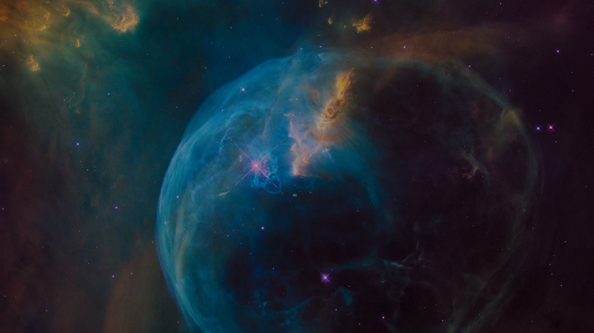
Search & Save Your Favorite Space Images

Slide 3

Create Portfolio
Users are able to login to create a new portfolio, or manage an existing one.
Simply login and “flip the switch” on whatever images you’d like to keep for later viewing.

Slide 4
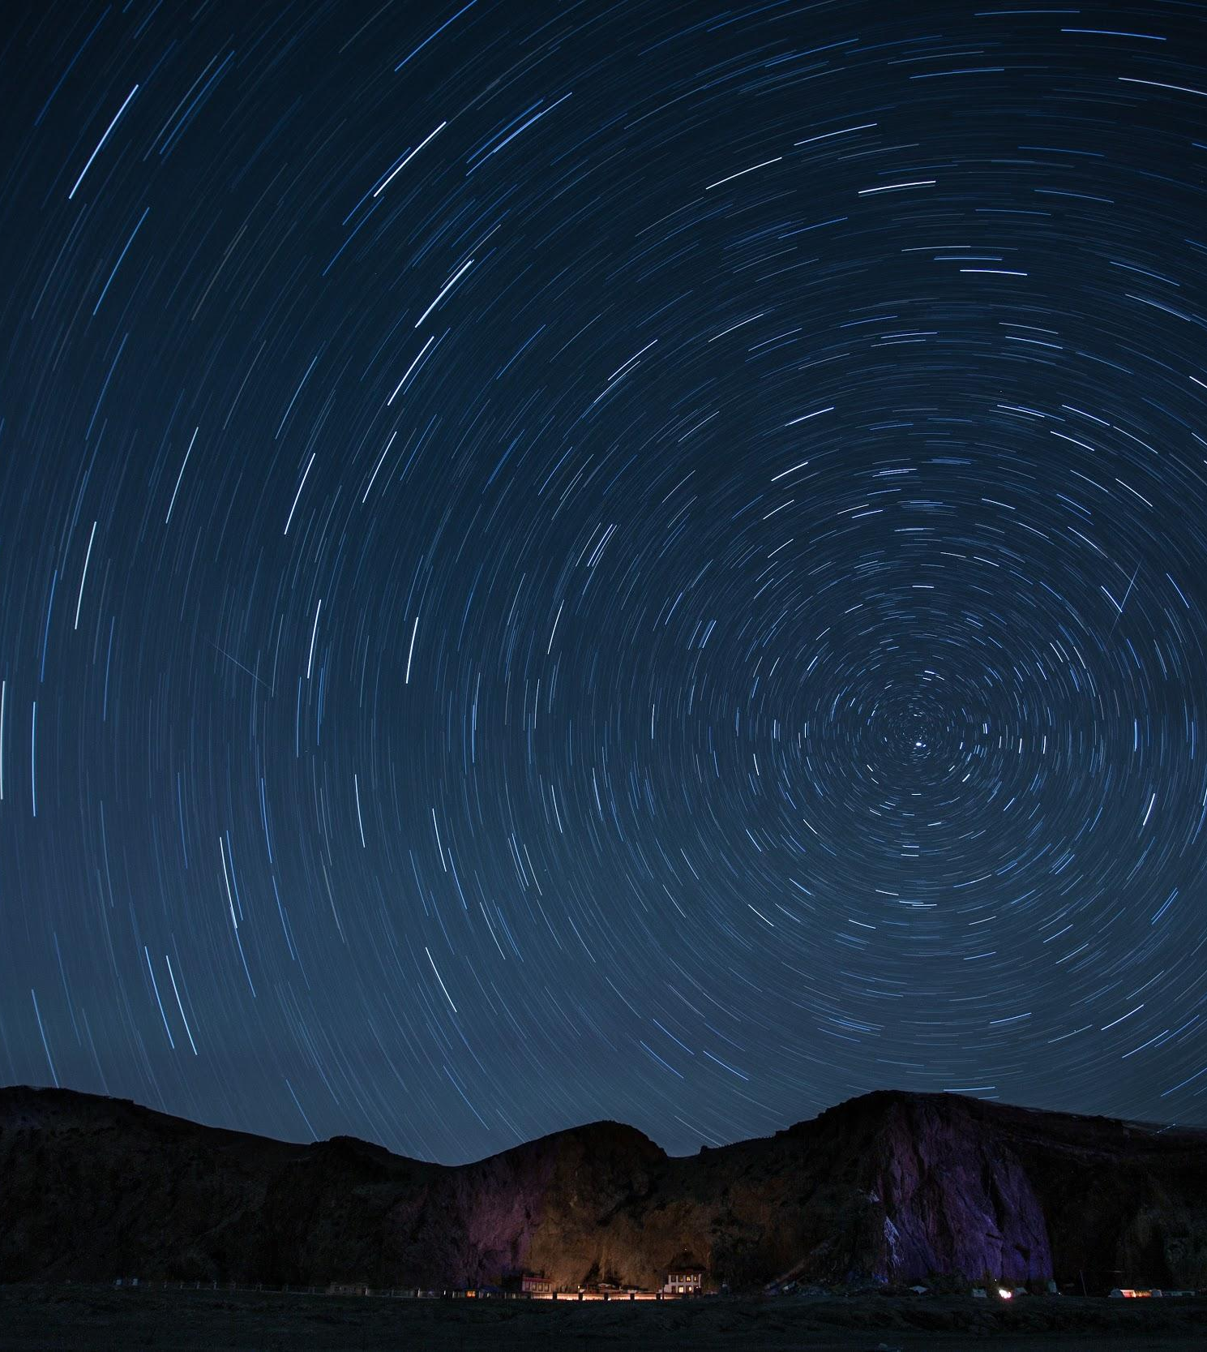
View In Lightbox Or Reveal More
Users are able to view HD images within a lightbox, or reveal additional information by interacting with the cards.

Slide 5

Milestones
Day 1
Day 4
Day 7
Day 10
Day 2
Day 6
Day 12
Day 3
Day 9
Brainstorming
NASA API Link
Database
Mobile First Styling
1 | 2 | 3 | 4 | 5 | 6 | 7 | 8 | 9 | 10 | 11 | 12
HTML Skeleton & Wireframing
File Organization
Click Events
UX & UI
QA

Slide 6
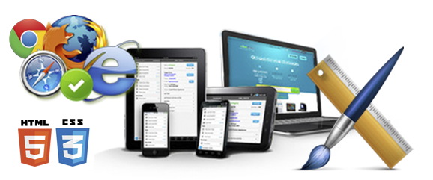
How It Works
National Data
Slick UI
Fluid UX
NASA API
Parallax & Smooth Scrolling
Minimal Landing & Limited Distractions

Slide 7
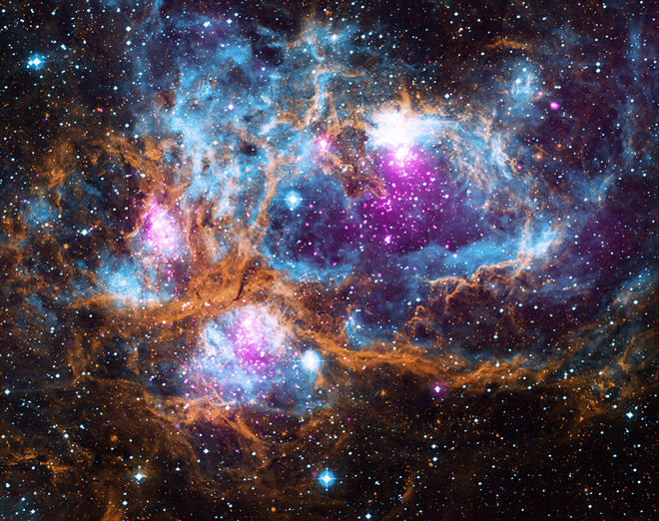
New Technologies
MaterializeCSS
NASA APOD API
Passport
Bcrypt-nodejs
Lightbox2

Slide 8
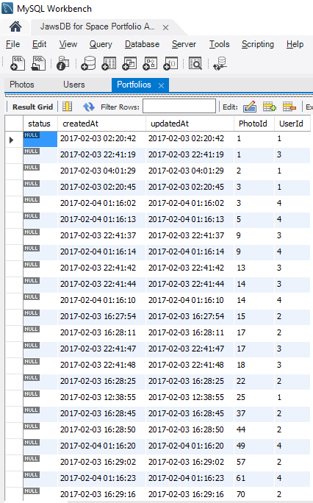
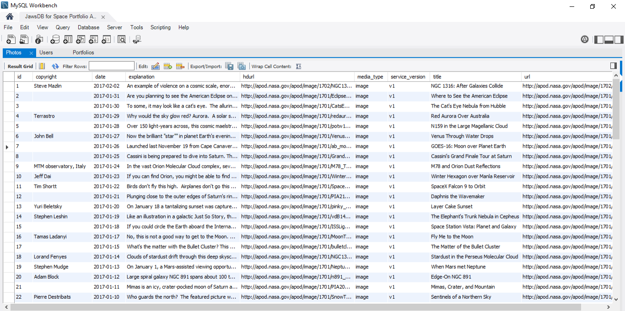
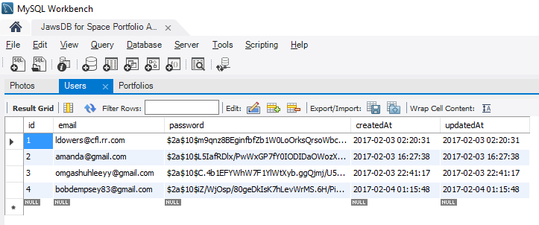

Slide 9

Demo Time!

Slide 10
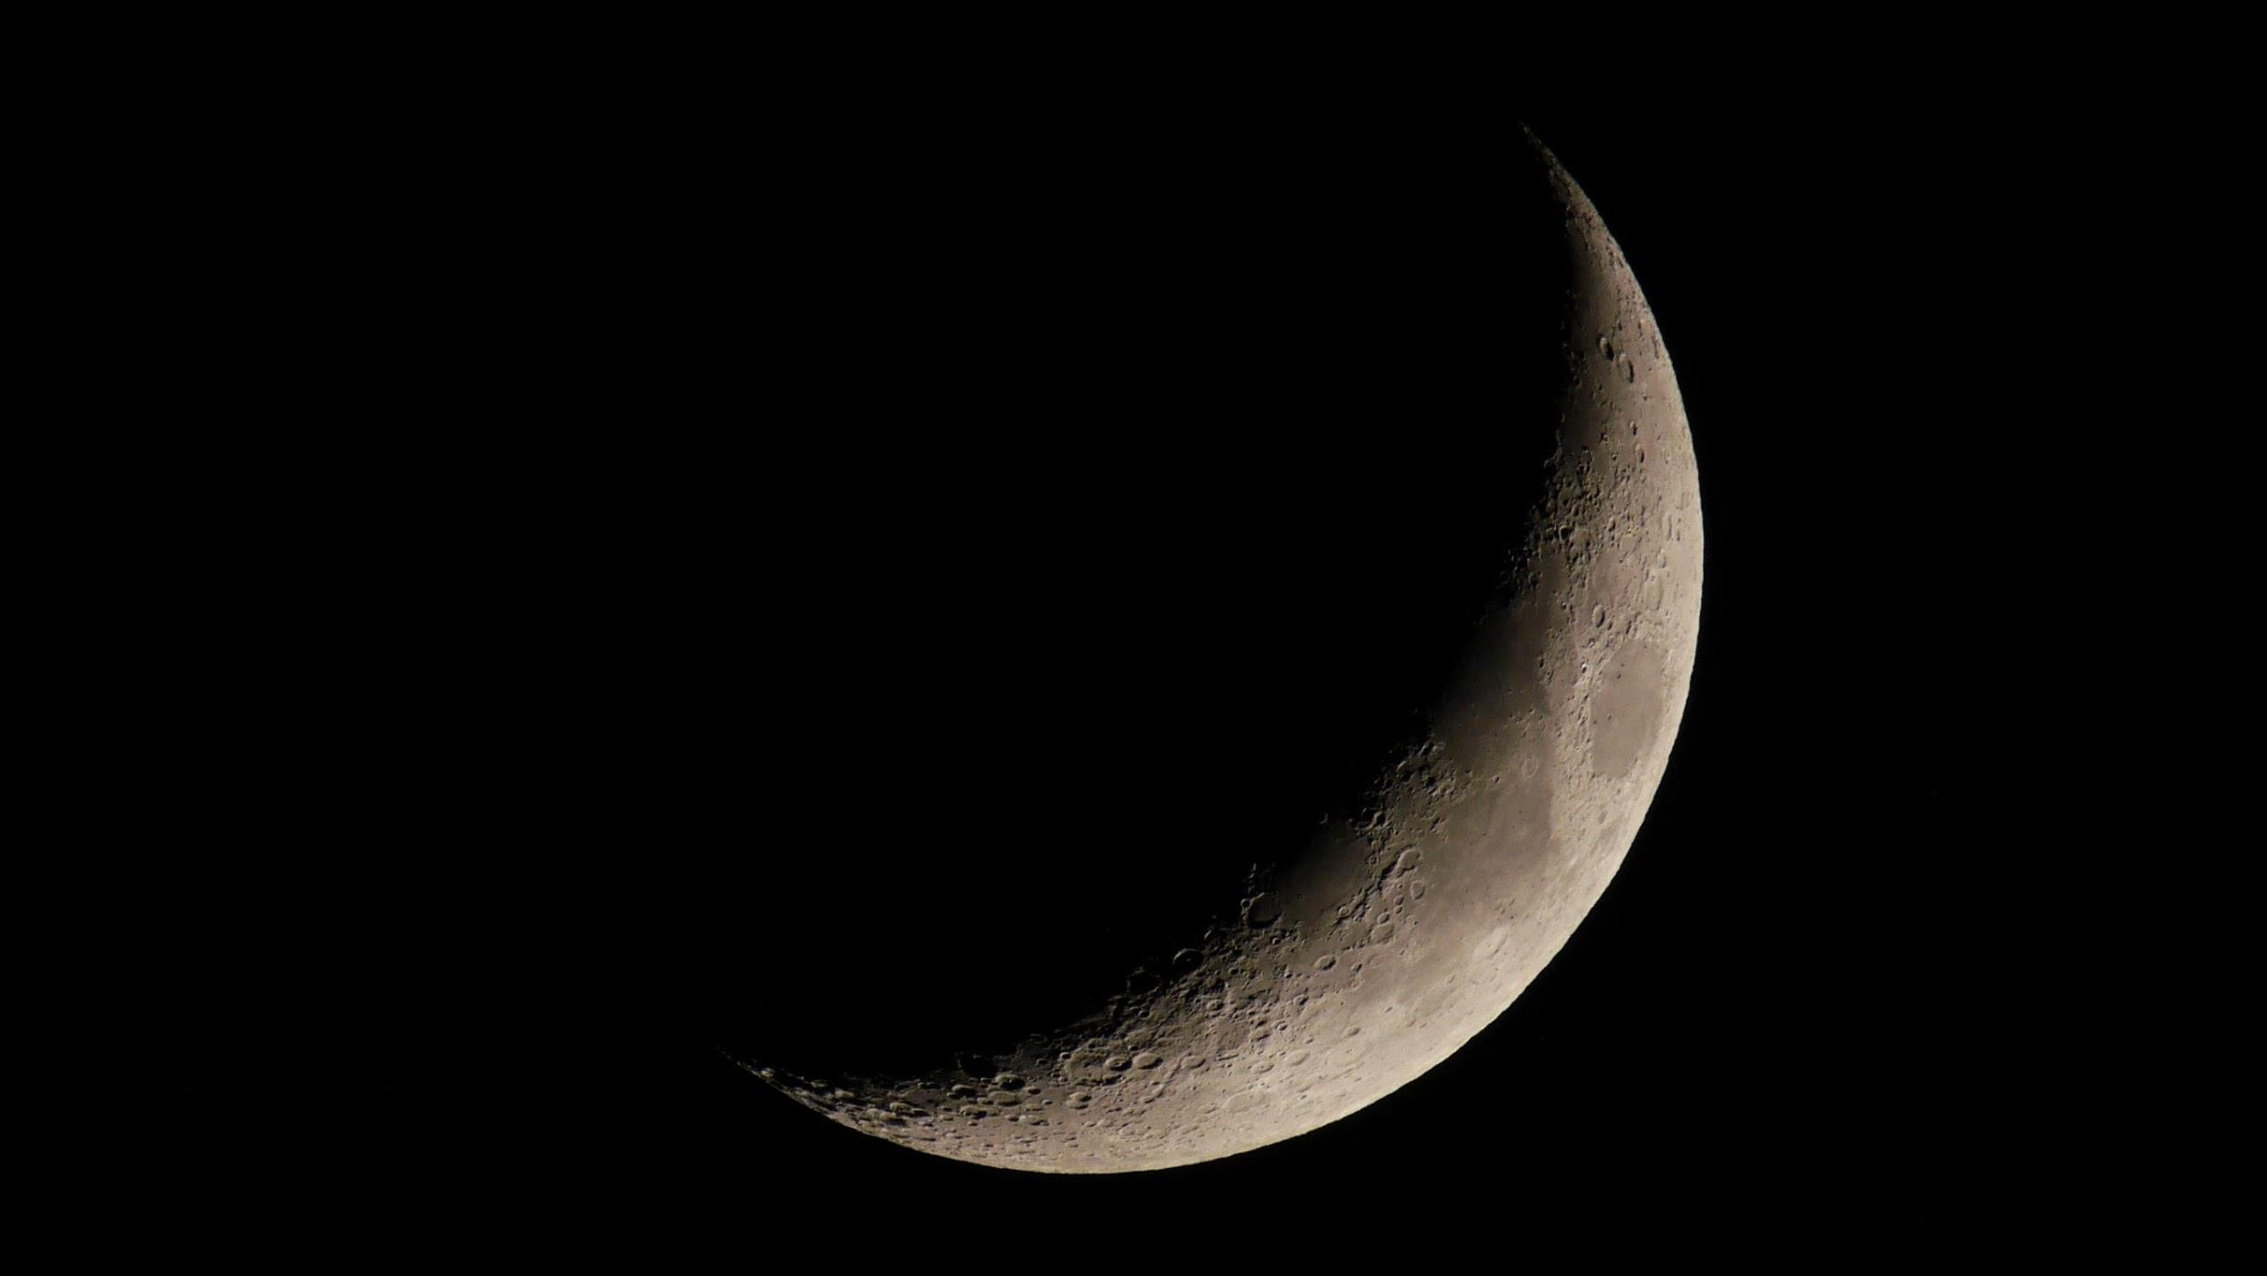
Wish List
Change photo card slider to default on when photo is in user's portfolio
Add View by Category option
Add Save and Share features (e.g. save to file, share on Instagram/Facebook/Twitter)
Add more data and photos from other sources
Add User Rating feature so users can rate photos from 1-5, share their ratings with other users, and view top-rated photos
Speed up load time

Slide 11



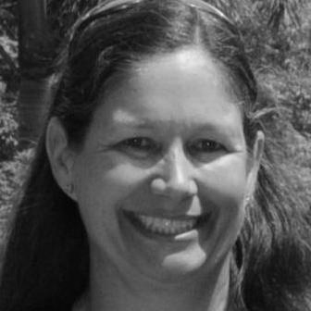

The Team
Ashley Reid
Bob Dempsey
Lori Dowers
Amanda Wang
Front End
Front End
Back End
Back End

